Slide 1
Unified mentor Front-End Development Internship :
Tic-Tac-Toe
My Portfolio
Weather App
To-Do App
Basic Calculator
Recipe Book
Music Player
Interactive Resume
Info
Graphics
Virtual Pet Simu
This presentation showcases web development project: Image Slider. This project utilize HTML, CSS, and JavaScript, demonstrating my coding skills and project development experience. This project highlight my ability to create interactive and engaging web applications, showcasing my passion for web development and commitment to building high-quality, user-friendly website.
A Web Development Showcase
Memory Card Game
Interactive Quiz
Countdown Timer
Blog Website
Virtual Art gallery
by Mandadi Rohit Reddy
Internship ID: UMIP278665
M R
Chat Application
Interactive Story telling
Interactive Map
Image Slider
Expense Tracker

Slide 2

IMAGE SLIDER Using HTML, CSS, and JavaScript
A Simple and Interactive Web Component
Presented by: Rohit Reddy Mandadi

Slide 3




INTRODUCTION
The Image Slider is a web-based component that enables users to view a collection of images in a slideshow format. This project demonstrates how to create a fully functional and responsive image slider using only core web technologies — HTML, CSS, and JavaScript — without relying on any external libraries or frameworks.

Slide 4
🎯 Project Objectives: Image Slider Using HTML, CSS, and JavaScript
Design a slider that works seamlessly across devices (desktop, tablet, mobile).
Use CSS animations or JavaScript to create smooth sliding effects between images.
01
02
03
04
Create a Responsive Image Slider
Implement Smooth Transitions
Enable Manual Navigation
Add Auto-Sliding Functionality
Add a timer-based automatic transition between images for a slideshow effect.
Focus on integrating AI and ML to enhance operational efficiency and product offerings.
Add “Next” and “Previous” buttons to navigate through images manually.
Include a timer to automatically change images after a few seconds.

Slide 5
05
06
07
08
Integrate Navigation Indicators
Optimize for Performance
Use Clean and Maintainable Code
Enhance UI with Styling
Apply visually appealing styles using CSS (e.g., shadows, borders, hover effects).
Use dots or thumbnails to show the number of slides and allow direct access.
Use optimized images and efficient code to ensure fast loading and smooth transitions.
Structure HTML, CSS, and JavaScript for readability and future updates.

Slide 6



🛠️ Technologies Used:
HTML – For structure and content
CSS – For styling and transitions
JavaScript – For interactivity and logic

Slide 7
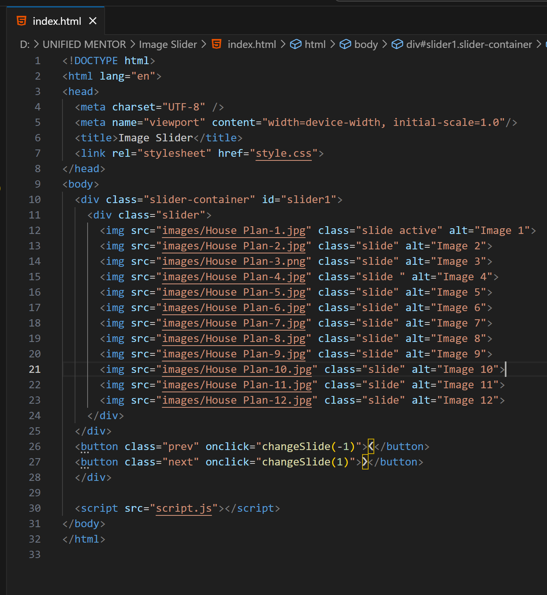
HTML Structure

Slide 8
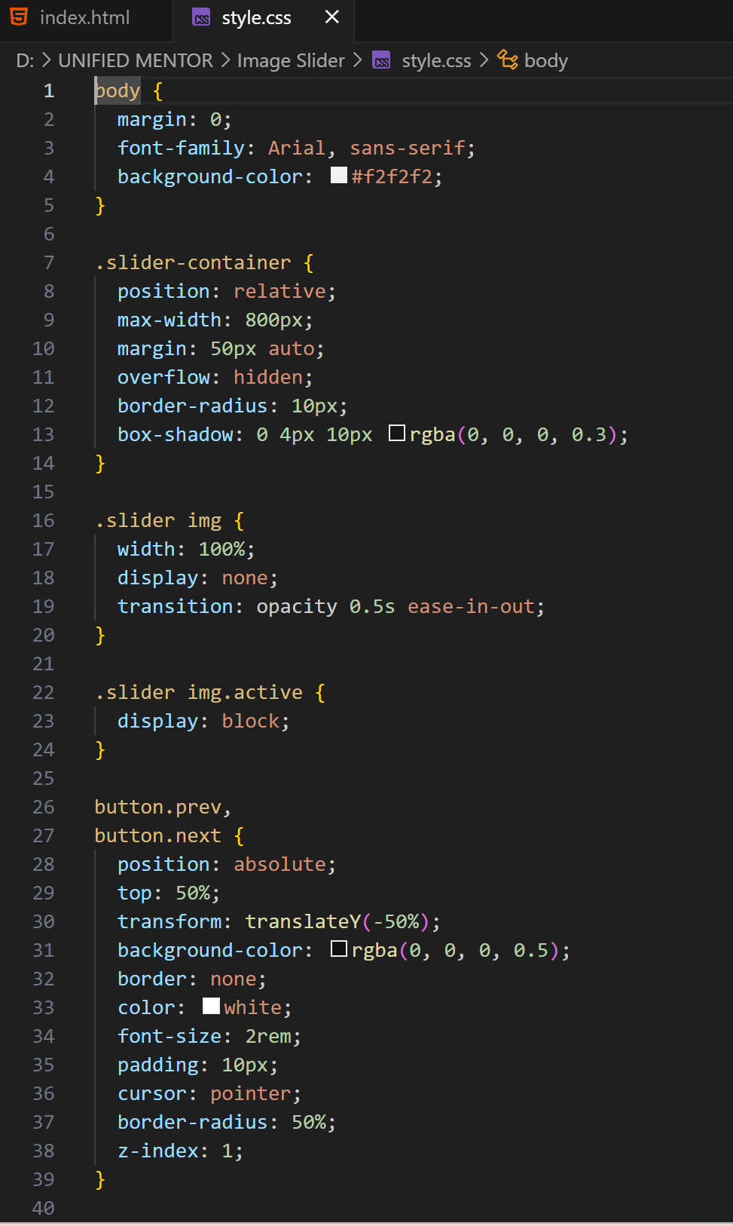
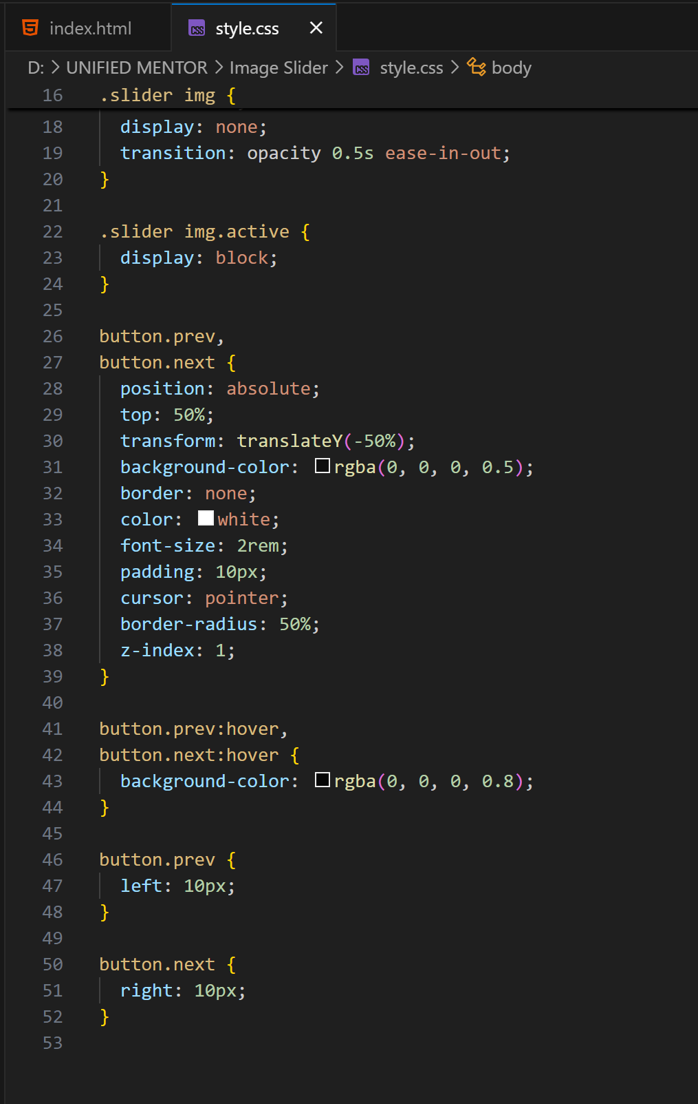
CSS Structure

Slide 9
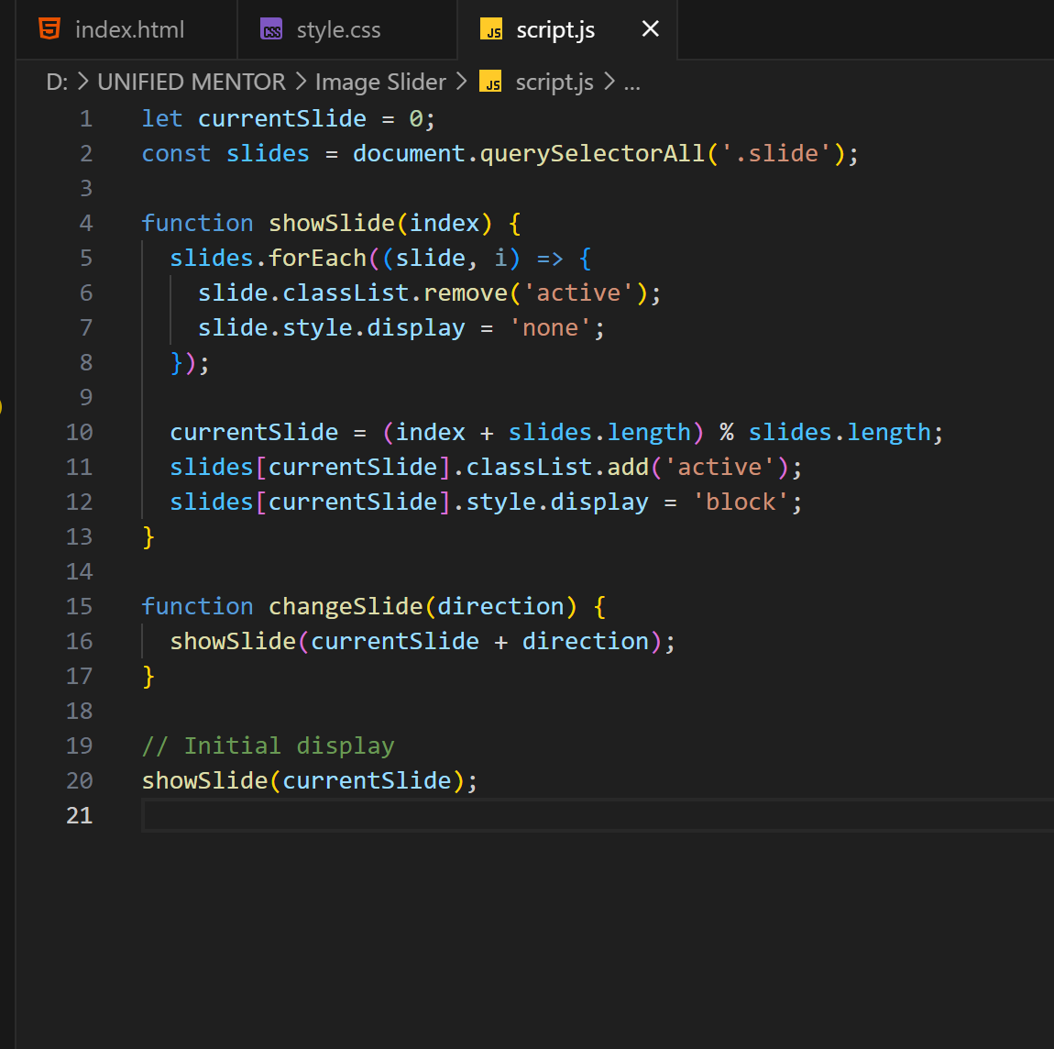
Javascript Structure

Slide 10
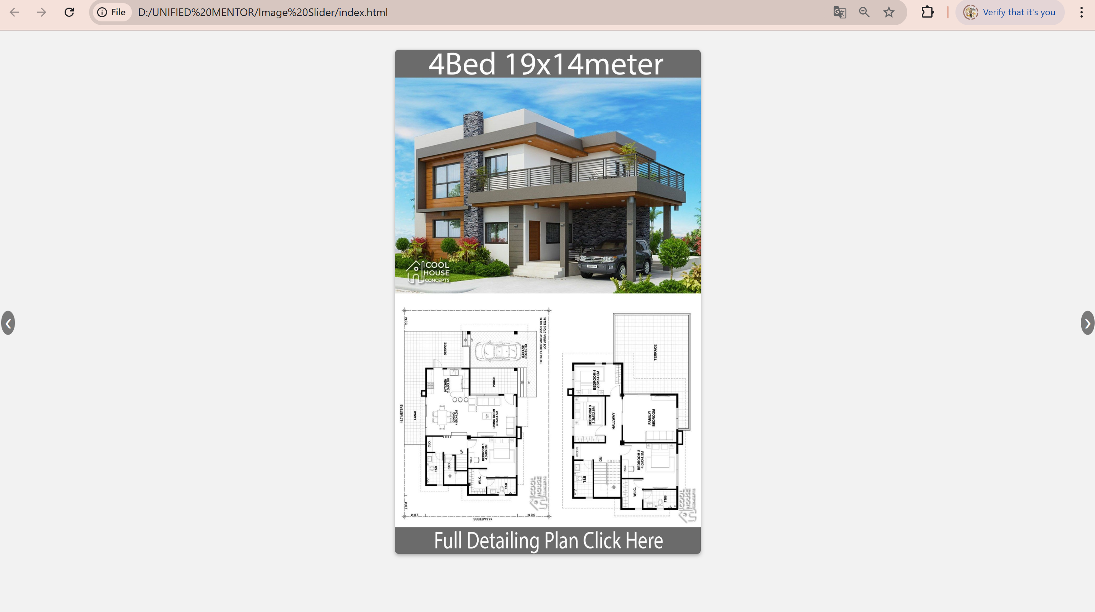
OUTput

Slide 11

demo

Slide 12
Social Media Links
Company's Governance Structure and CSR Initiatives

Slide 13
conclusion
The Image Slider project successfully demonstrates how HTML, CSS, and JavaScript can be integrated to create an interactive and visually appealing user interface component. This slider allows users to seamlessly navigate through a collection of images with forward and backward navigation controls. The implementation emphasizes responsive design, smooth transitions, and a clean layout, making it a great feature for modern web applications and portfolios.

Slide 14
Future Enhancements
01
02
03
04
Auto Slide Feature
Dynamic Image Loading
Transition Effects
Touch/Swipe Support
Add a timer-based automatic transition between images for a slideshow effect.
Focus on integrating AI and ML to enhance operational efficiency and product offerings.
Add more advanced CSS or JS-based animations like fade, zoom, or slide-in effects.
Enhance mobile usability by enabling swipe gestures for navigation.

Slide 15

Thank you

